Slide 1
Kumon Award Ceremony
2016 Excellence Awards

Slide 2
Important Announcements
Parents are requested to please remain seated and attend the complete ceremony. We have important announcements for the upcoming year at the end of the ceremony.
If you have NOT been receiving emails from us, then please fill out the email address in the feedback form and submit the form outside before leaving.

Slide 3

Level UP Event

Slide 4
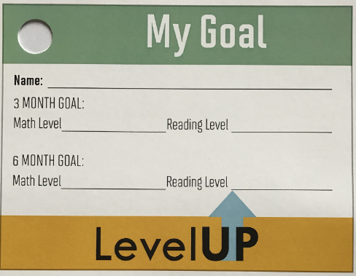
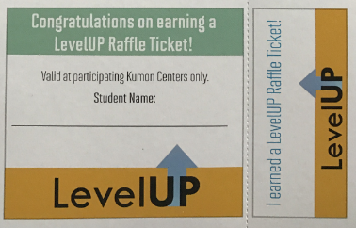
Up Coming Events

Slide 5

Win Prizes / Movie Night in Feb
We will draw raffle and celebrate the event with Snacks and a Movie in February. Details on the Date will be announced later.

Slide 6

Join Us / Like Us / Rate Us

Slide 7
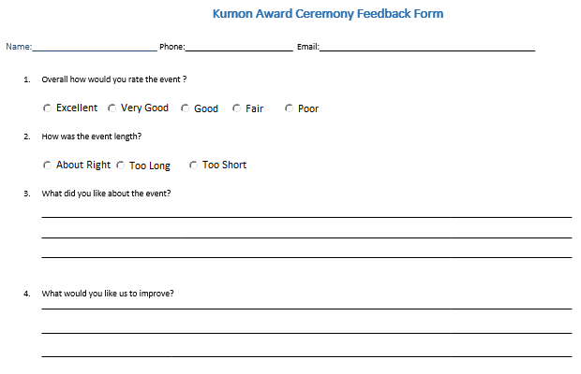
Award Ceremony Feedback

